Slide 1
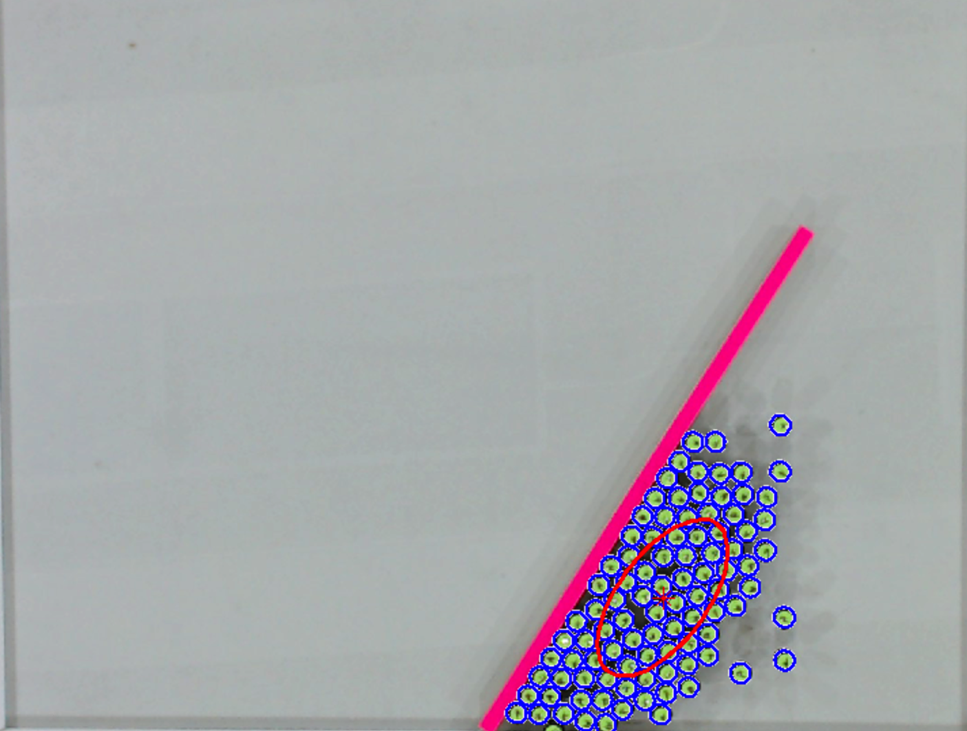

Detected Robots
Mean Position +
Covariance Ellipse
Object
Goal
Pivot
Notes:
Draw

Slide 2
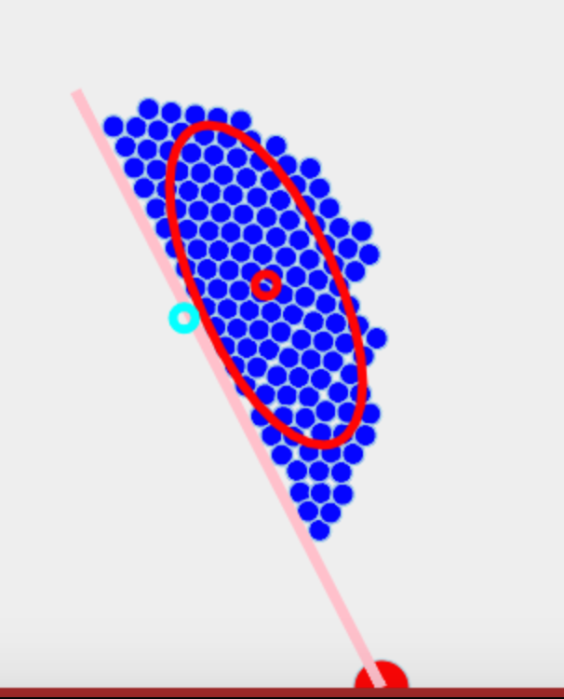
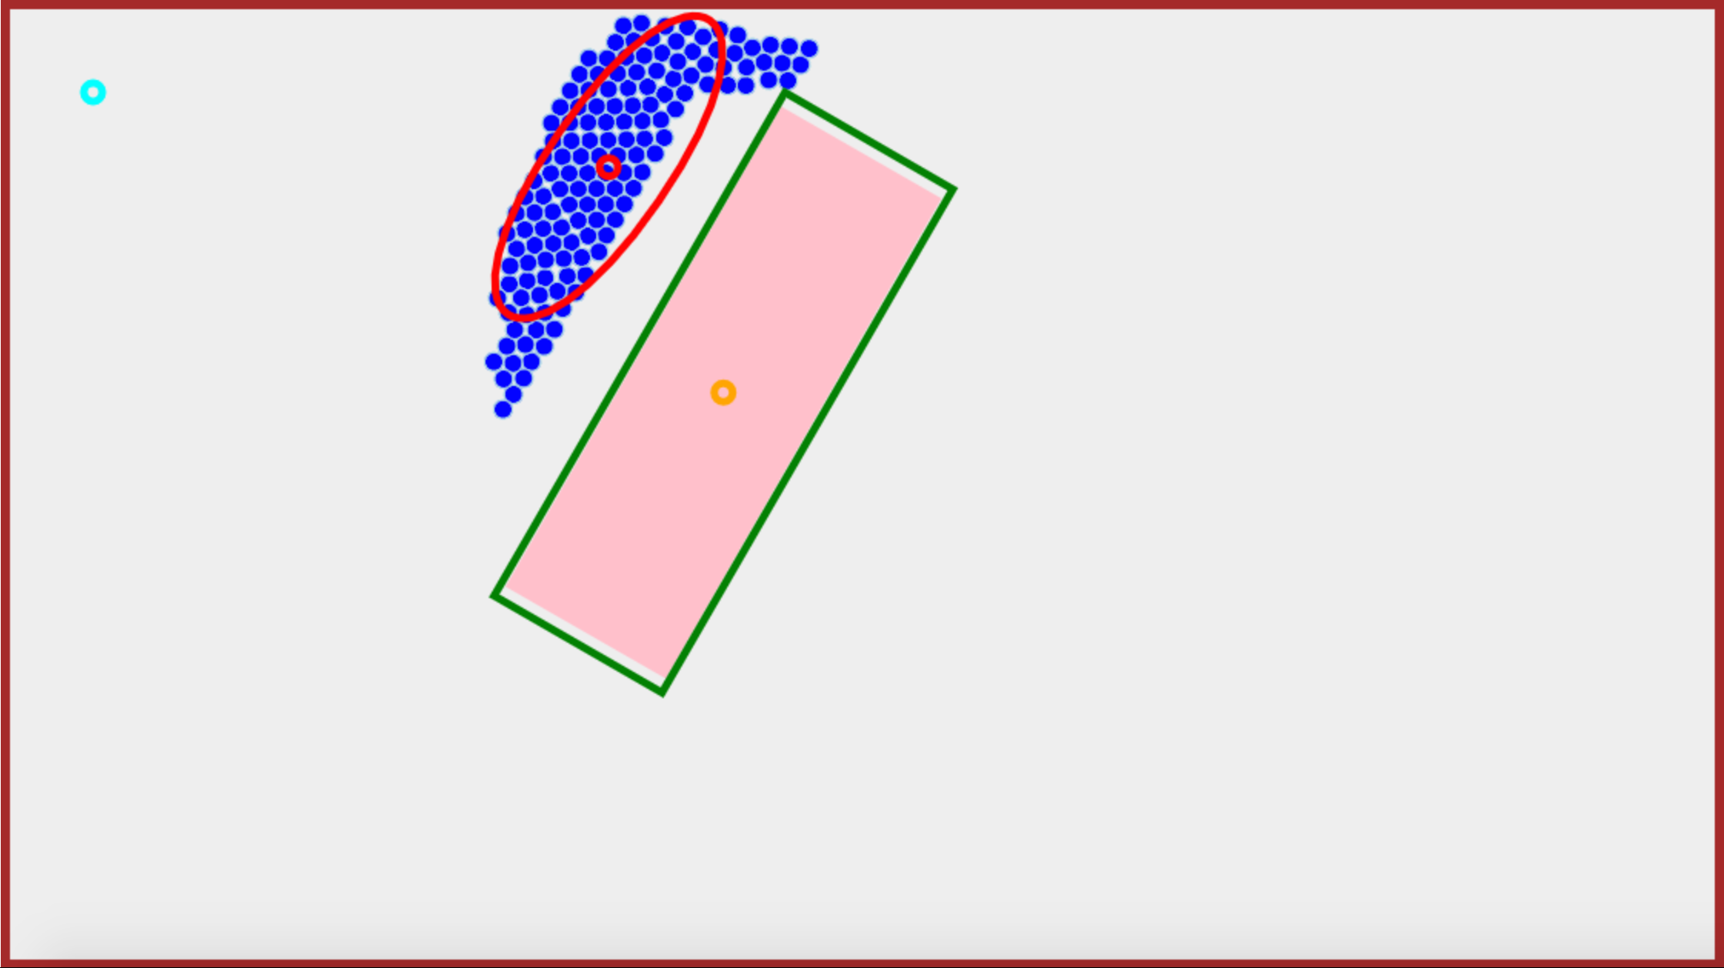
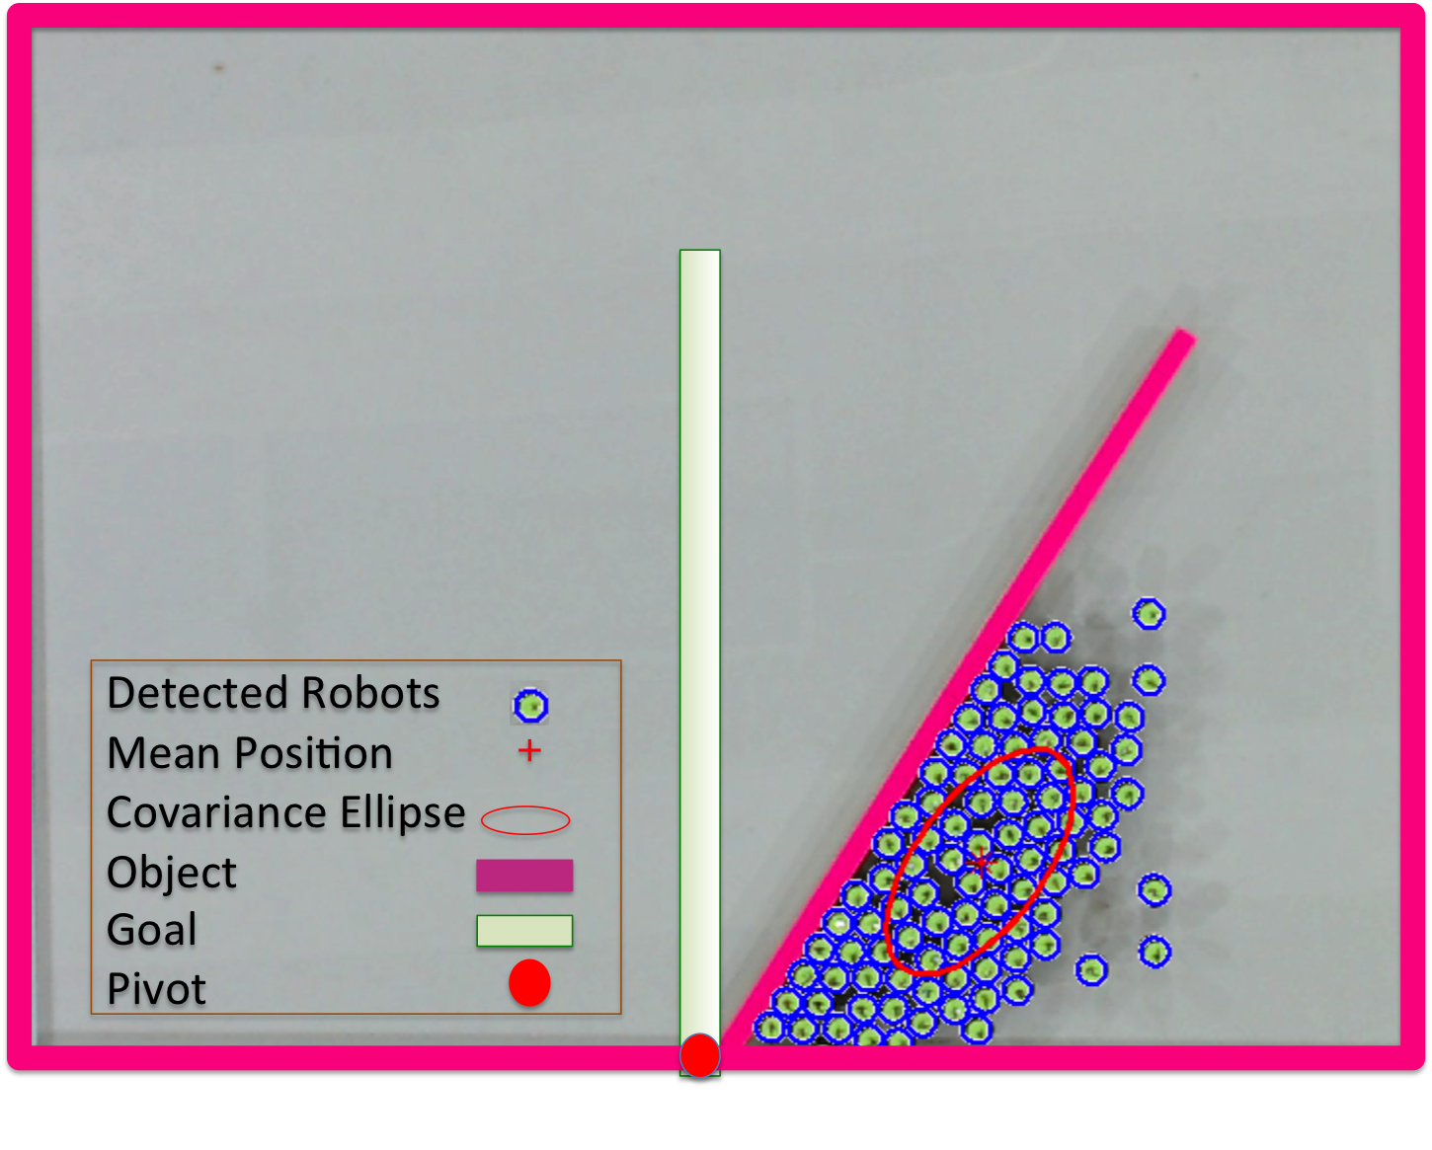
Robots
COM
Mean Position
Goal Position
Block
Goal Angle
r
a)
b)
c)
Direction of Light
θ

Slide 3
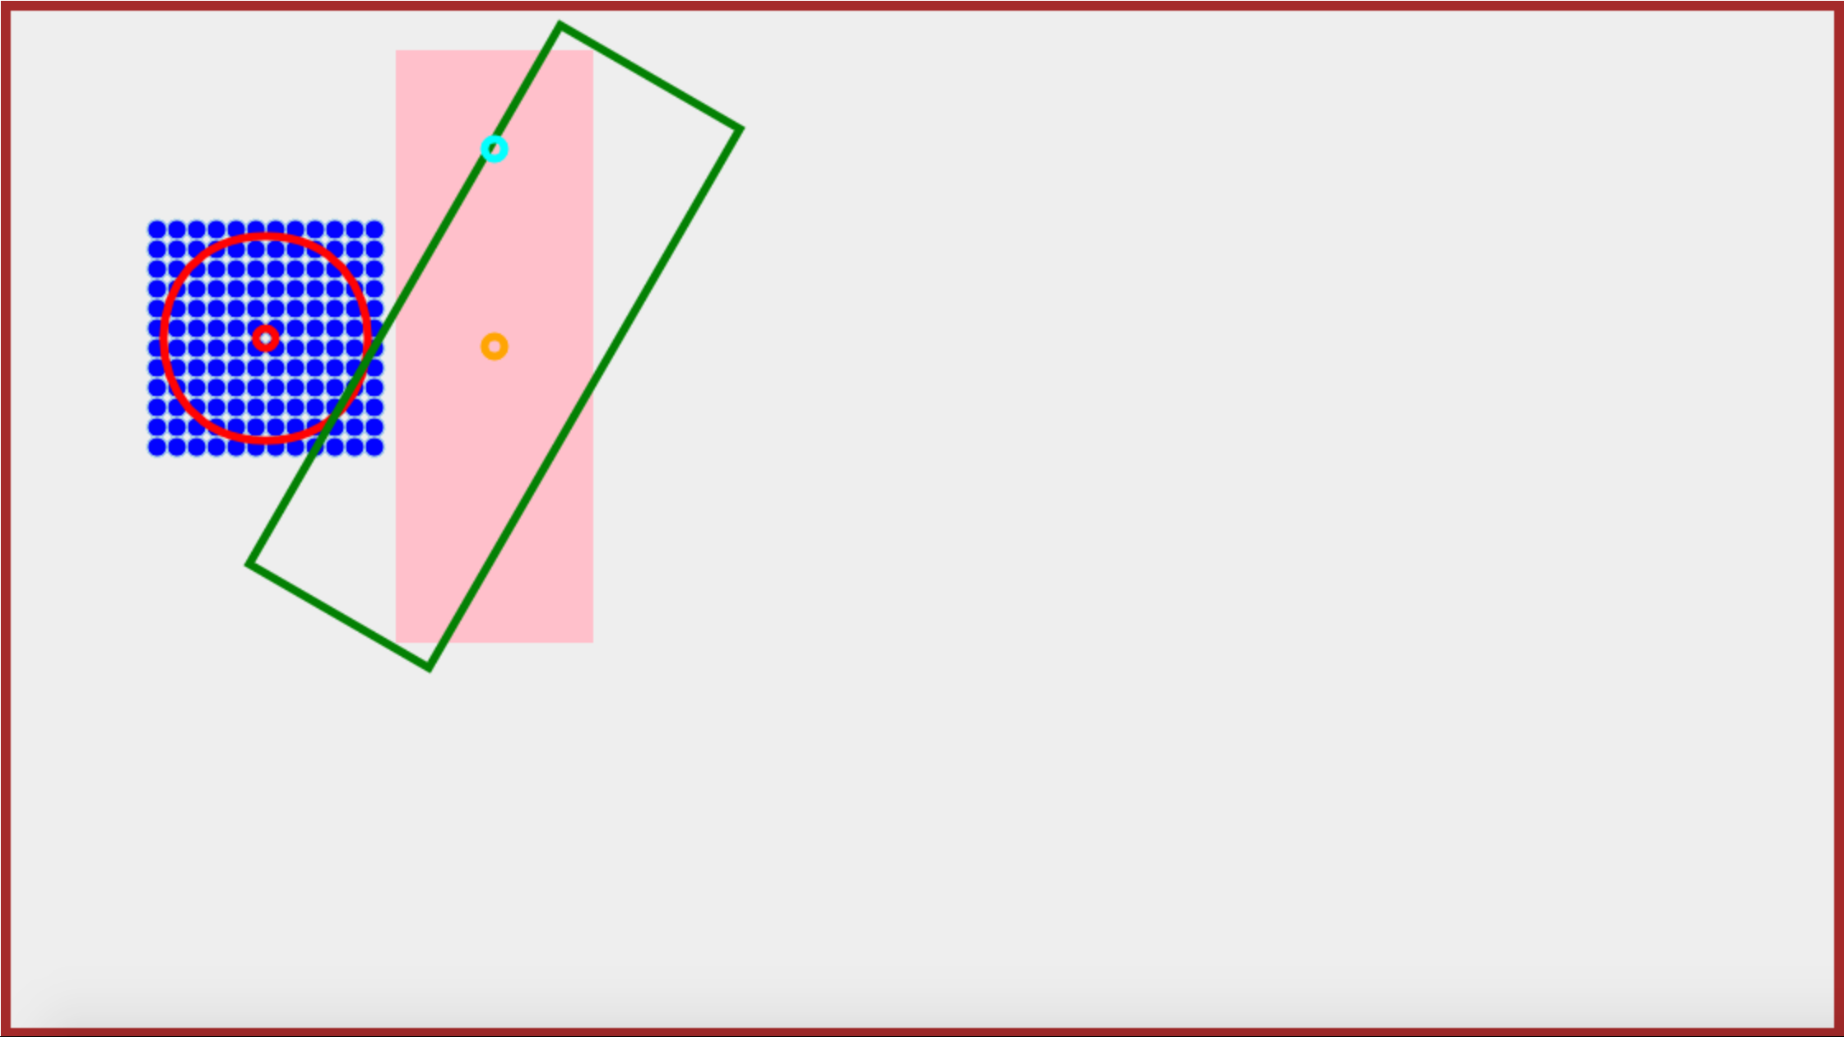
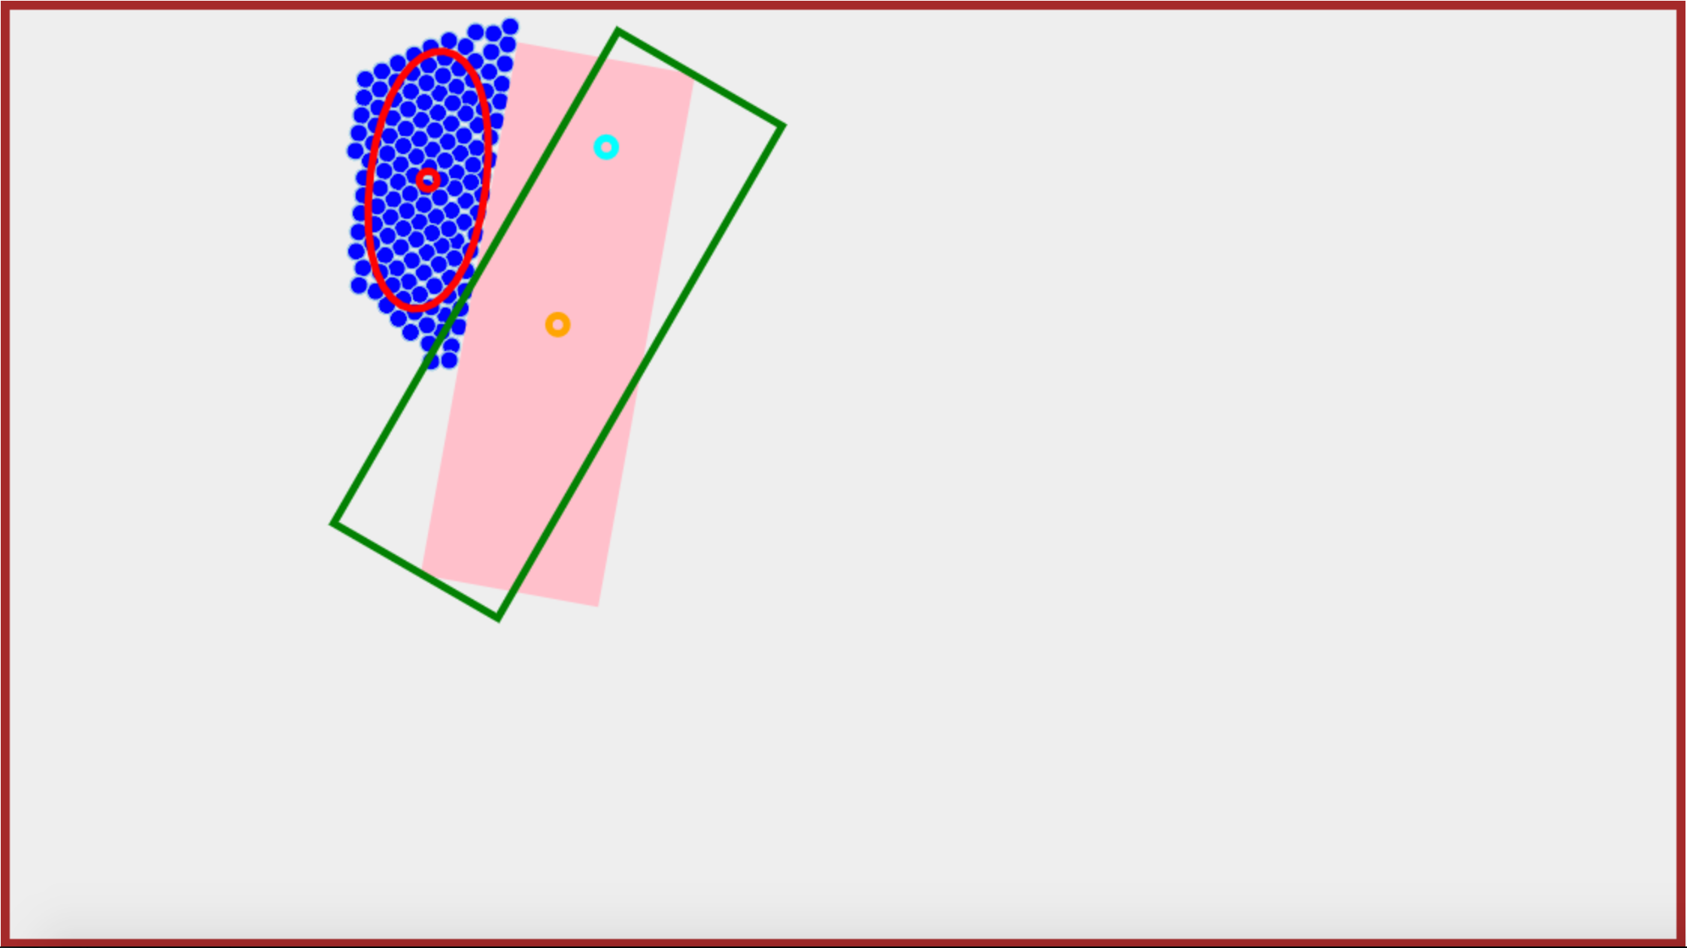
t= 0
t= 5s
t= 15
Robots
COM
Mean Position
Goal Position
Block
Goal Angle
12m
13m
15m

Slide 4
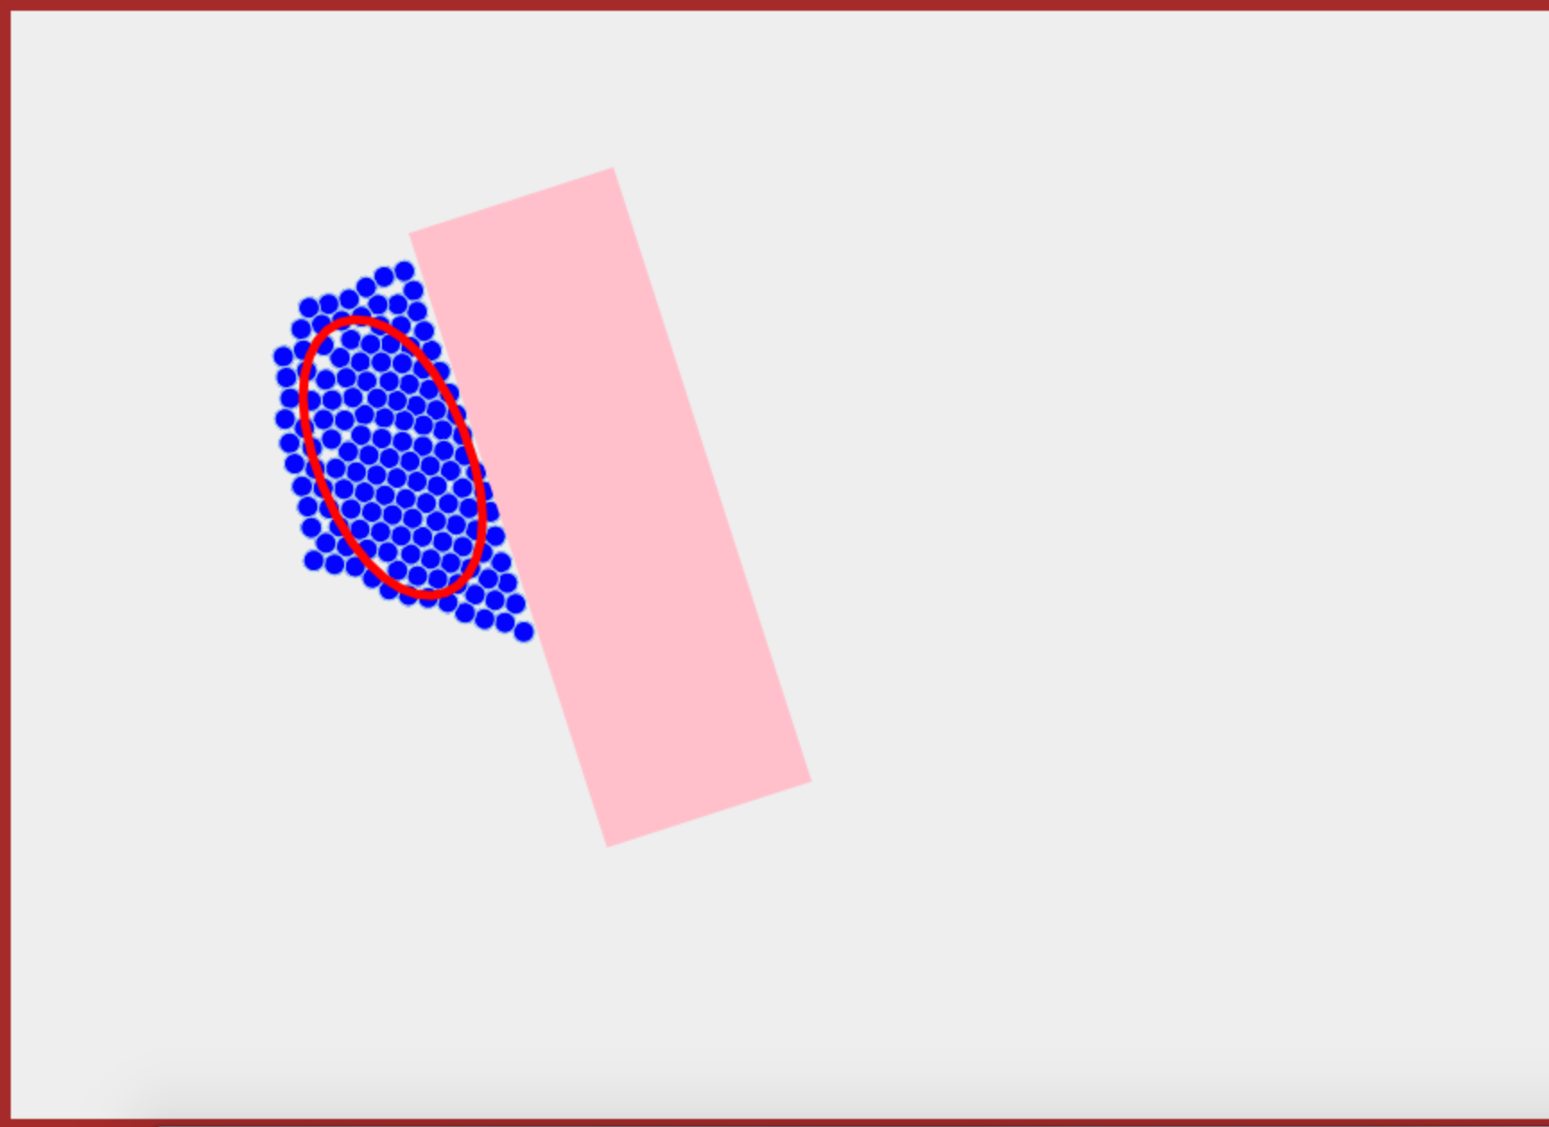
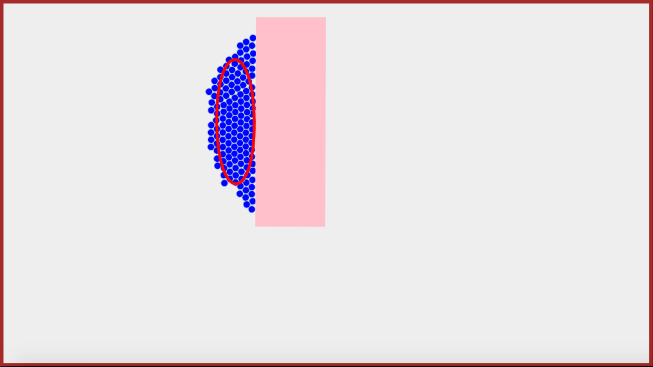
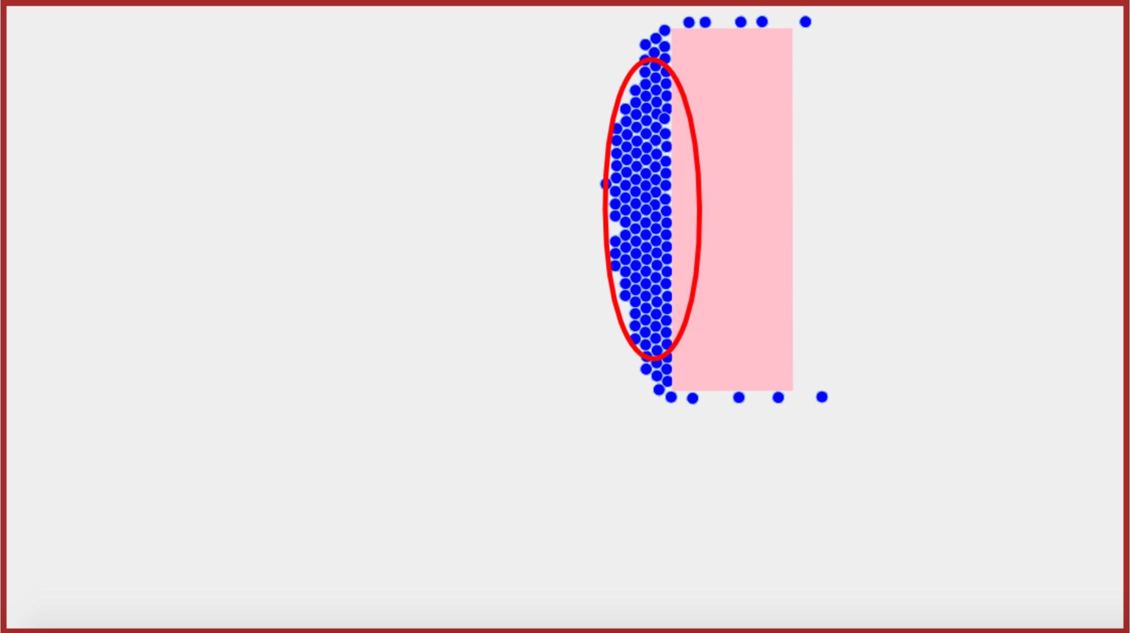
t = 5
t = 15
t = 25
Robots
Covariance Ellipse
Block
11m
18m
25m

Slide 5
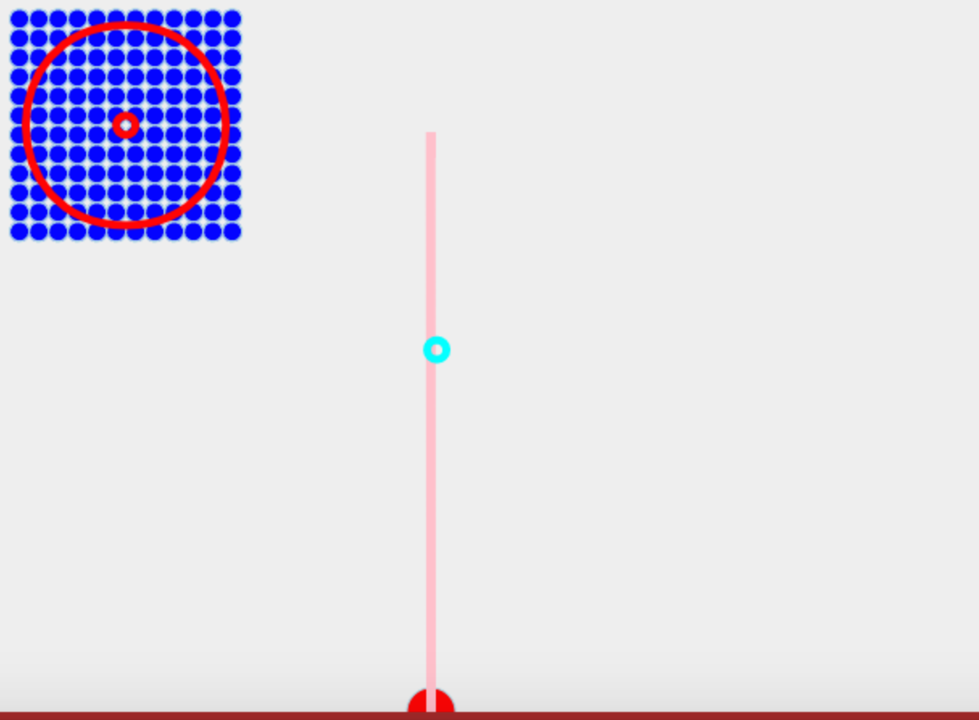
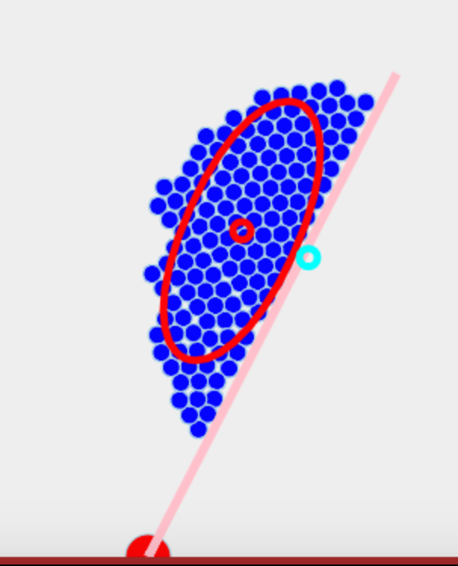
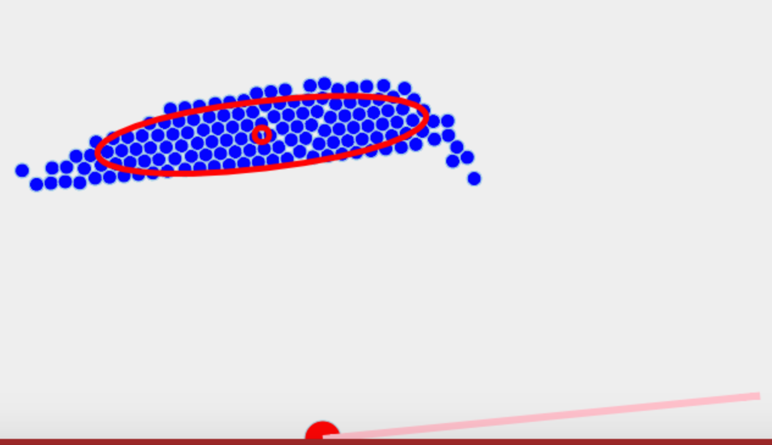
t = 0
t = 15
t = 30
Robots
Mean Position
Goal Position
Block
Pivot
C

Slide 6
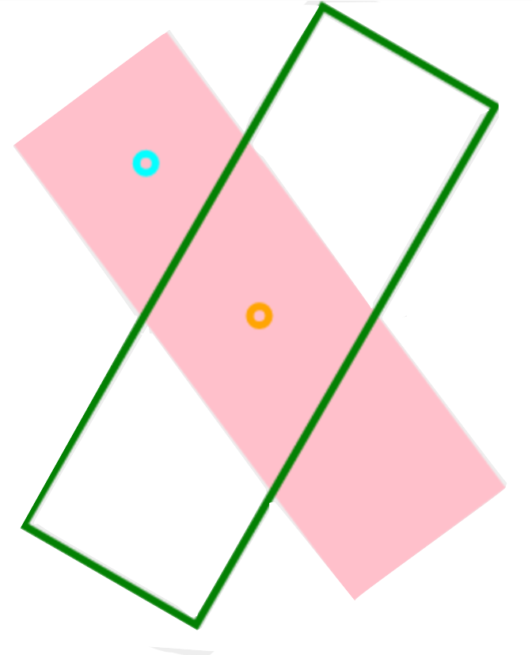
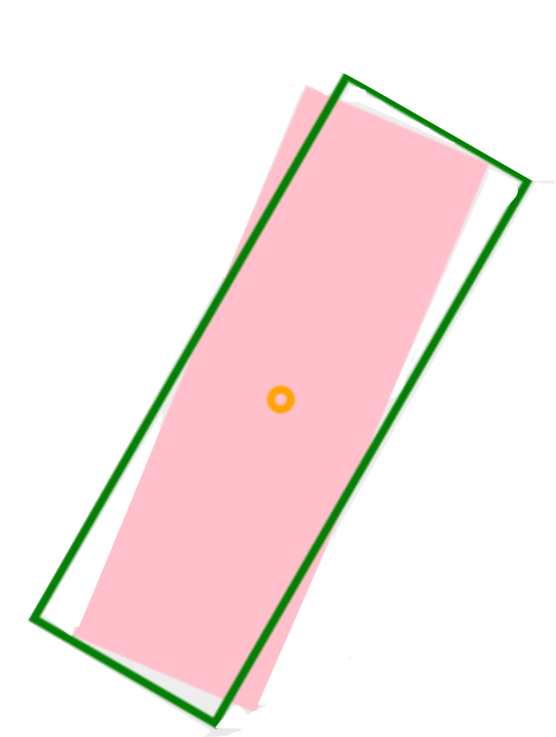
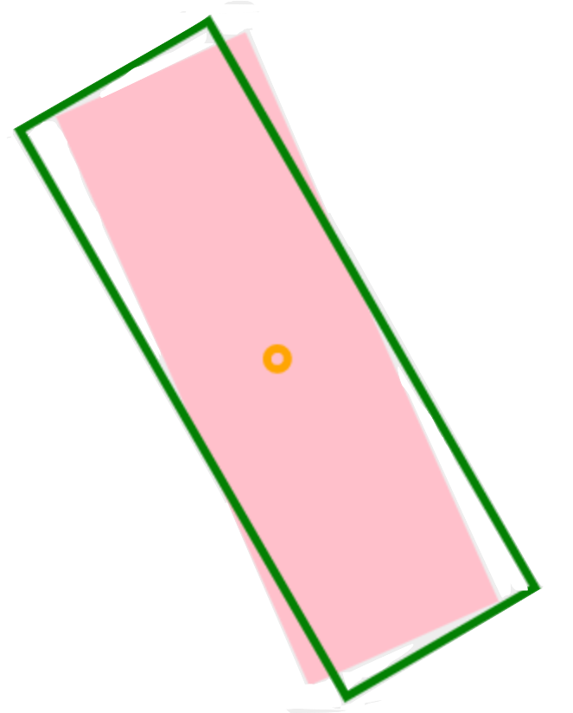
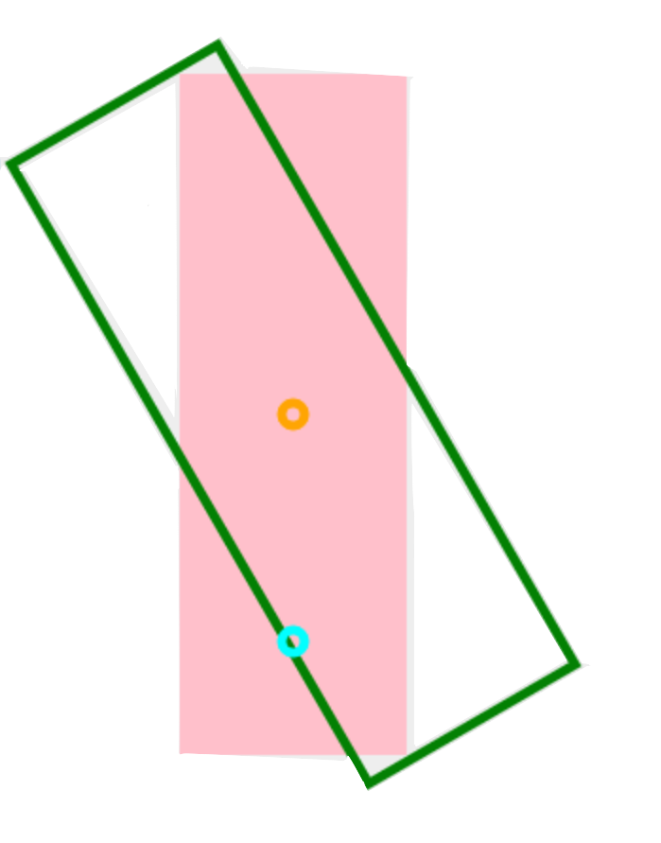
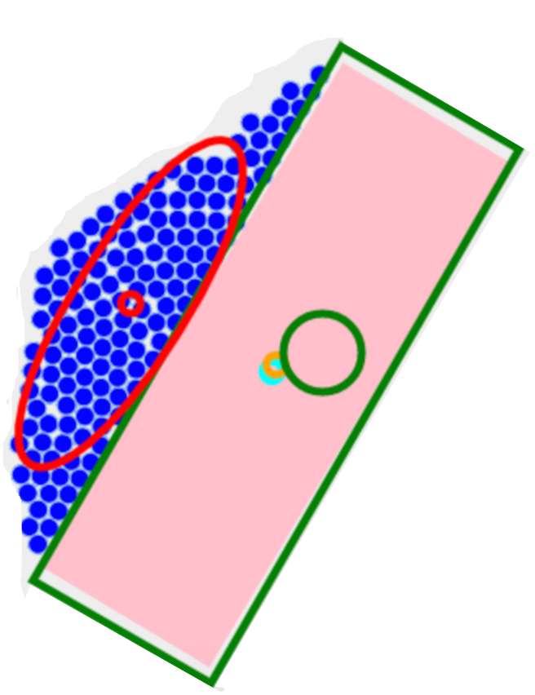
Robots
COM
Mean Position
Goal Position
Block
Goal Angle
Goal Distance

